Slide 1
Prototypes
Project Idea Presentation
CCU 2020

Slide 2
Team
Project Manager
User-research Lead
Design Lead
Front-end Developer
Back-end Developer
Documentation Lead
Francisco Mira
Francisco Cecílio
Isabel Soares
Lídia Custódio
Ricardo Machado
Filipe Amaral

Slide 3
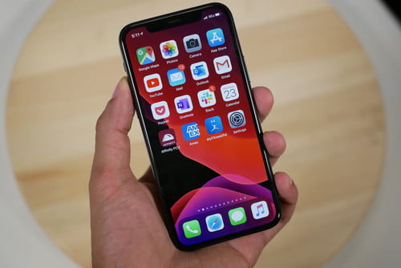
Project Idea
Recomendation system
Avoid crowds
Create a path that goes through the places you want to go
Applied in enclosured spaces: zoos, shopping malls, museums, amusement parks…

Slide 4
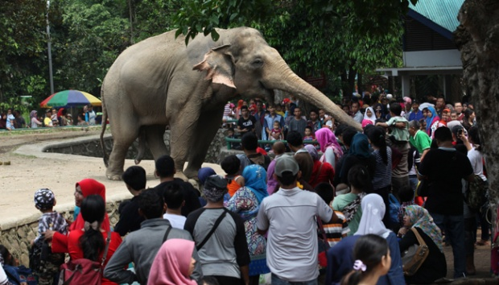
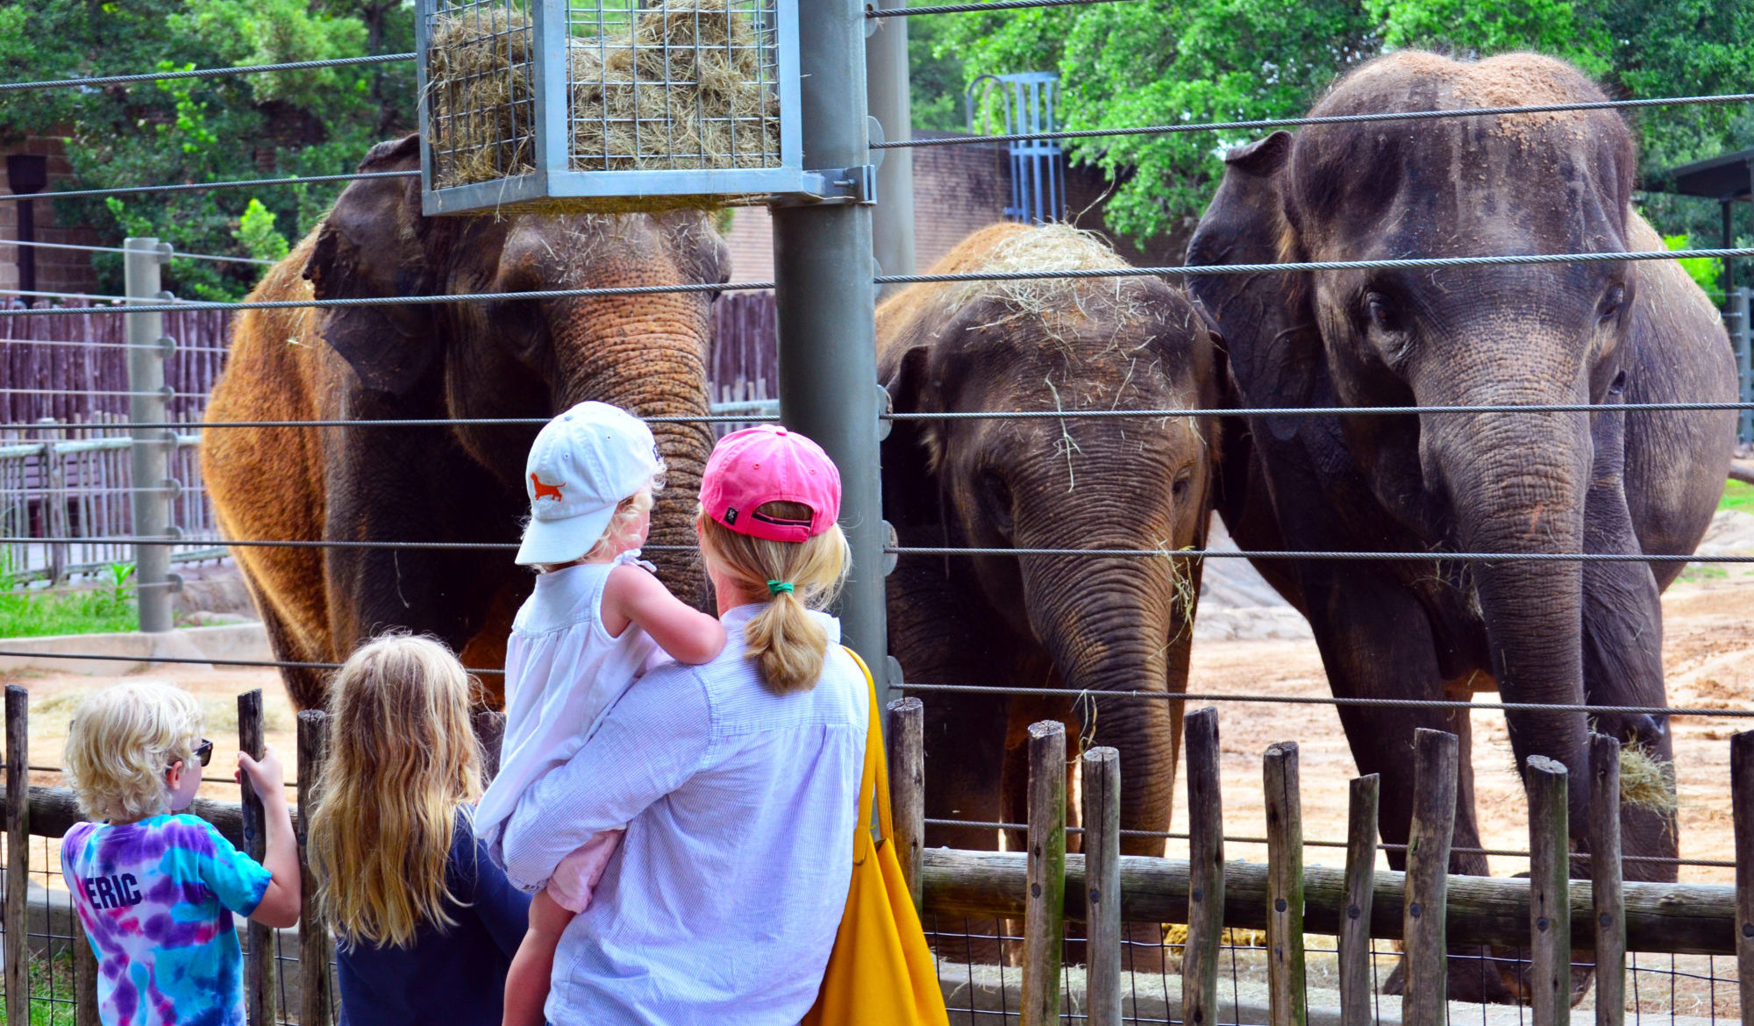

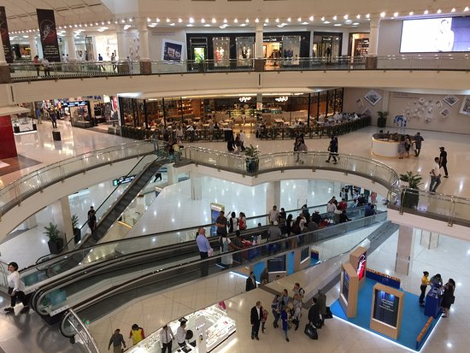

Slide 5
SQVID

Slide 6
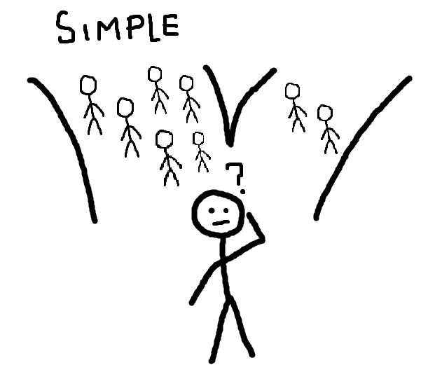
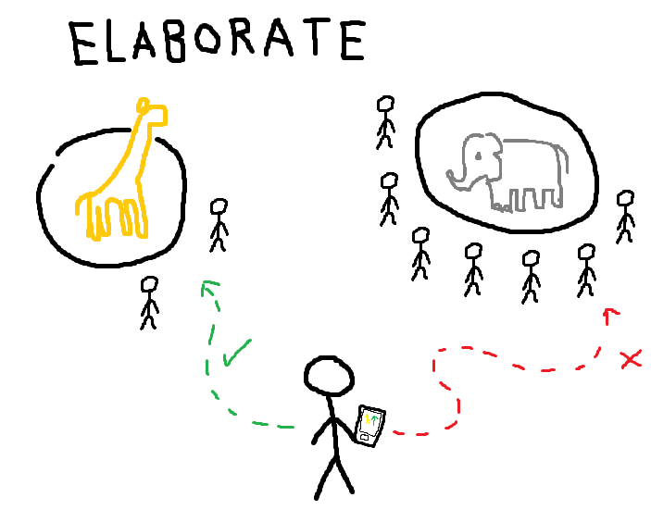

Slide 7
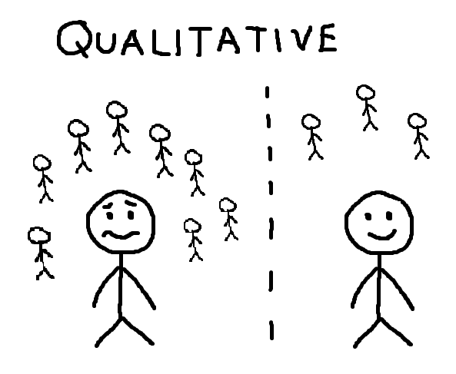
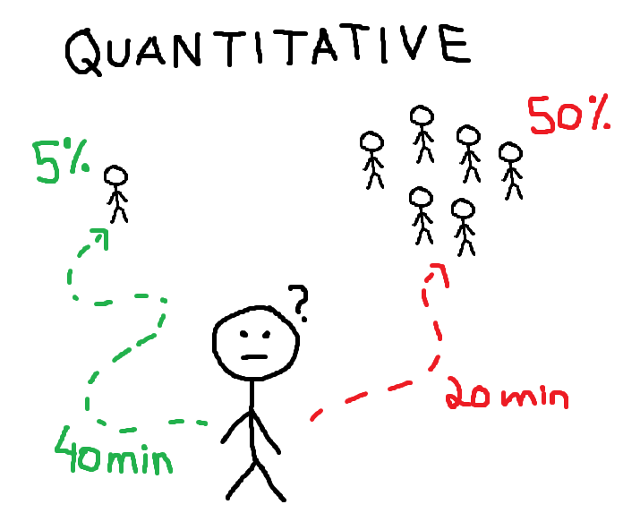

Slide 8
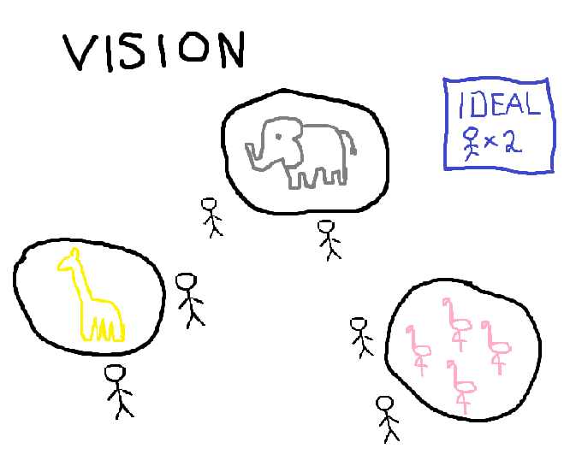
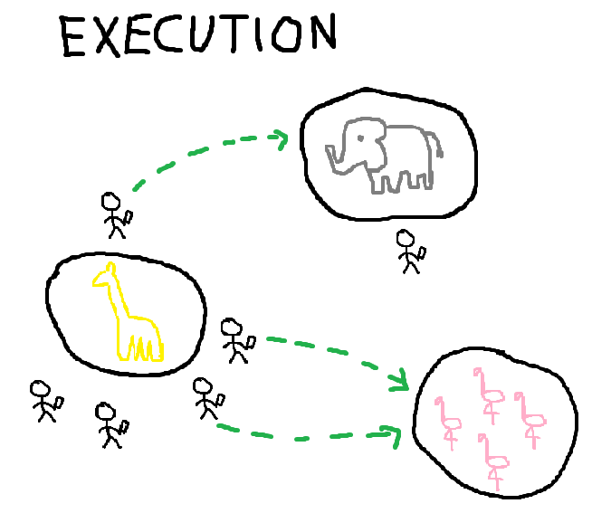

Slide 9
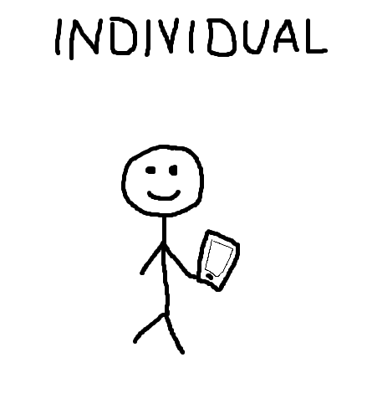
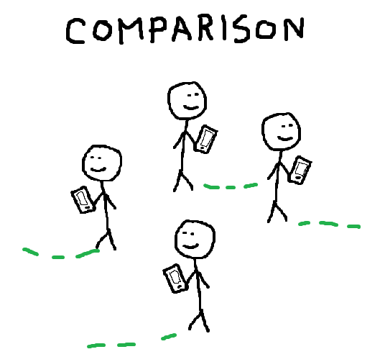

Slide 10
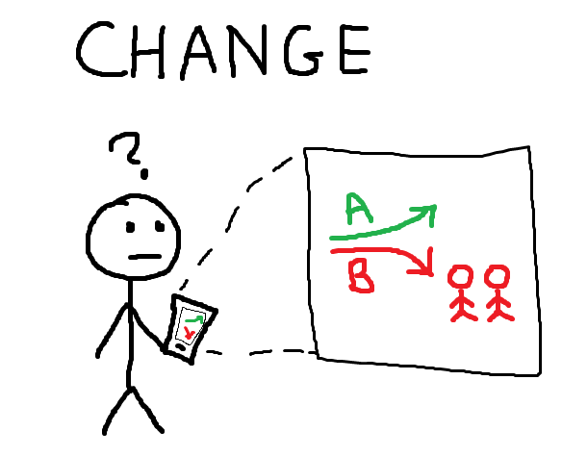
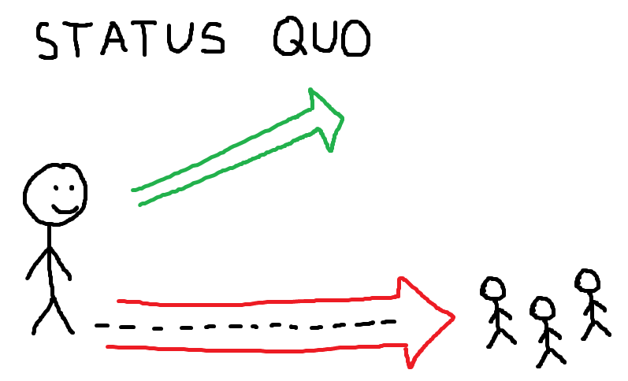

Slide 11
Questions?
424759 - Filipe Amaral
189444 - Francisco Cecílio
180888 - Francisco Mira
189466 - Isabel Soares
189492 - Lídia Custódio
179751 - Ricardo Machado

